Slide 1




Python Flow Control
Class
viii
Lab 19
Supported by
Powered By

Slide 2

Flowchart
a graphical representation of a computer program in relation to its sequence of functions
Supported by
Powered By

Slide 3
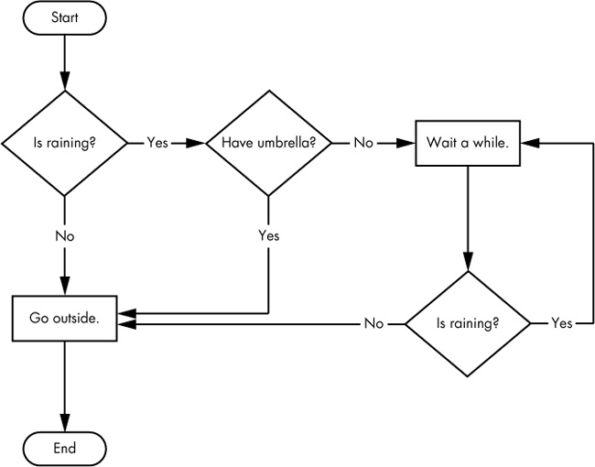
Flowchart Drawing
You have to start from a point and go through some of the conditions and target is to go to the end
Supported by
Powered By

Slide 4



Boolean Values
The Boolean data types has only two values. True & False
>>> spam = True
>>>spam
True
>>>
>>>2==2
True
>>>
Supported by
Powered By

Slide 5
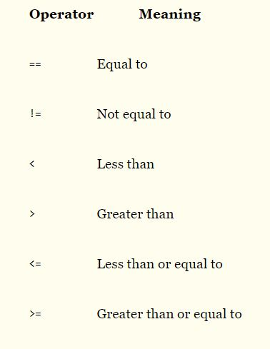
Comparison Operator
compare two values and evaluate down to a single Boolean value
Supported by
Powered By

Slide 6
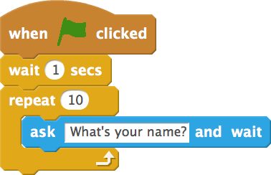
Blocks of Code
Blocks begin when the indentation increases.
Blocks can contain other blocks.
Blocks end when the indentation decreases to zero or to a containing block’s indentation.
Supported by
Powered By

Slide 7

If Statement
compare two values and evaluate down to a single Boolean value
If life == boring:
print (“Be awesome and make a happy life”)
Supported by
Powered By

Slide 8
elif Statement
The elif statement is an “else if” statement that always follows an if or another elif statement. It provides another condition that is checked only if all of the previous conditions were False.
If burgerPrice < 500:
print (“burger kinbo”)
elif burgerPrice >= 800:
print (“kinbo na ei burger”)
elif burgerPrice == 150:
print (“2 ta khabo ekbare”)
Supported by
Powered By

Slide 9

Thank You!
You’ll learn logic implement from next lab

